Slide 1
Downtown DineHub
Group 4: Deepthi | Dharani | SaiPriya | Mahitha
University at Albany

Slide 2



Problem Statement
Limited dining options
Café only open 11AM–4PM Students/faculty leave campus lost time
No access to full meals during mornings/late afternoons
Opportunity
Convenient on‑campus meals
Improve satisfaction & engagement
Support local vendors
Generate revenue
Increase campus safety

Slide 3



Project Overview
Mini food court using under‑utilized space
2–3 rotating vendors
Seating, microwaves, outlets, signage, ADA access
POS with ITS support One‑semester pilot
Collect feedback for expansion

Slide 4

Scope Statement
Project Goal: Implement a one-semester pilot “Downtown DineHub” mini-food-court to improve meal accessibility for students and faculty at the UAlbany Downtown Campus.
Product Scope: Create a functional, safe, student-friendly meal space with rotating vendors, seating, utilities, and POS capability.

Slide 5

In-Scope vs Out-of-Scope
In-Scope
Minor space prep
Temporary vendor contracts
POS installation
Marketing & promotions
Pilot operations only
Out-of-Scope
Structural renovations
Permanent vendor contracts
Multi-campus expansion
Custom POS development

Slide 6





Objectives
Improve on‑campus food access Accessible environment strengthen Vendor partnerships
Project KPI’s
200+ transactions/day
70%+ satisfaction
POS uptime ≥95%
Vendor EH&S compliance positive Financial performance

Slide 7

Work BreakDown Structure
Initiation
Space Prep
Vendor Procurement
Technology Setup
Marketing
Operations and Monitoring
Evaluation

Slide 8


Project Schedule (14 weeks)
(week 3-5) Vendor Onboarding
(week 7-9) Marketing
(week 11-13) Monitoring
(week 10) Launch
(week 14) Final Evaluation
(week 1-3) Space Prep
(week 6) POS Setup & Testing

Slide 9
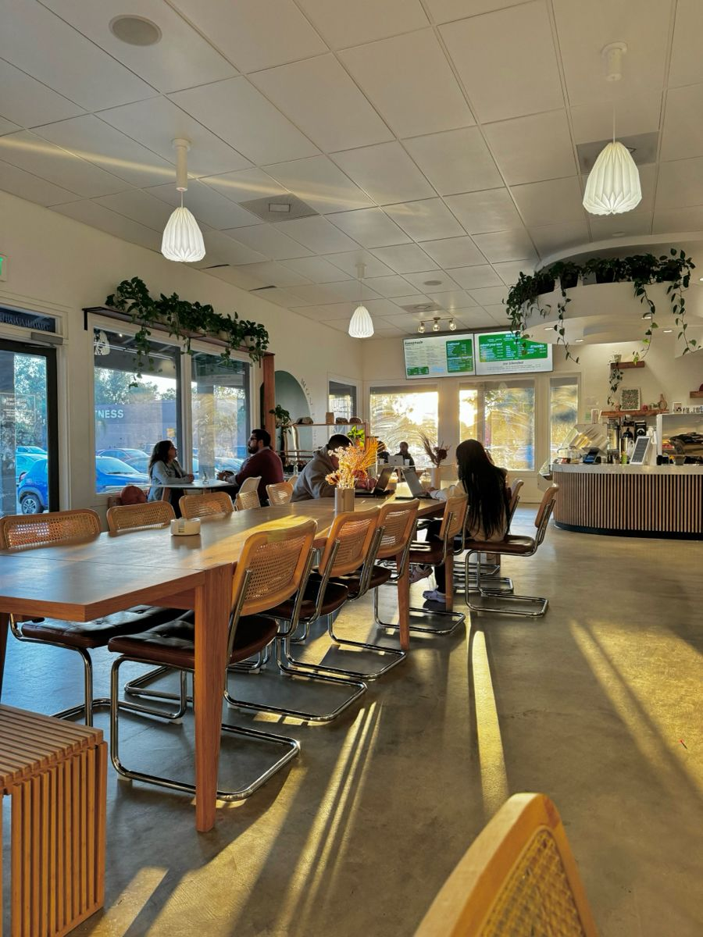
Budget Summary
Total cost: $35,348.33
Space Setup: $4,567.10
- Furniture: $2,500.00
Equipment: $750.00
- Signage: $1,317.10
Technology: $3,498.50
Permits/Insurance: $1,932.18
Supplies: $812.65
- Marketing: $2,456.12
Operations: $4,335.47
Staff Support: $2,986.99
- Subtotal: $30,058.11
- Contingency (12%): $3,606.97
Unknown‑risk buffer: $1,683.25

Slide 10
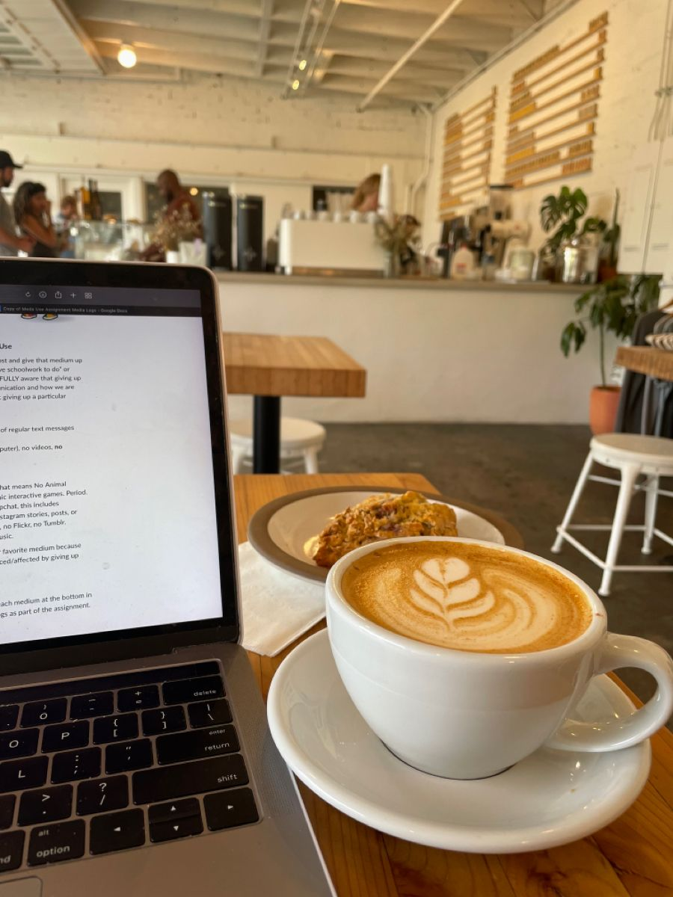
Stakeholder Analysis
Stakeholders:
University at Albany
Students & Faculty (Primary)
Auxiliary Services Facilities
EH&S ITS
Procurement Vendors
Engagement Methods:
Weekly team sync
Bi‑weekly updates
Vendor check‑ins
Monthly reviews
Roles & Responsibilities (RACI Summary)
PM: Accountable for project delivery, timeline, reporting
Vendors: Responsible for daily operations, food quality, cleanliness
Facilities: Responsible for space prep & maintenance
ITS: Responsible for POS setup, testing, uptime
Auxiliary Services: Vendor coordination & contract support
EH&S: Compliance checks & safety approvals

Slide 11

Communication Plan
Team: Weekly stand‑ups Stakeholders: Bi‑weekly emails Vendors: Weekly calls
Committee: Monthly review Campus: Posters & emails
Methods: Push, Pull, Interactive

Slide 12

Procurement Management
Procurement Approach:
Select 2–3 local vendors using short-term service agreements
Evaluate vendors based on menu fit, safety compliance, affordability, and capacity
Compensation model: commission-based or weekly rental fee
Vendor Responsibilities:
Provide staff, food prep, and cleanup
Maintain EH&S compliance

Slide 13

Risk Register Summary
Risk | Impact | Mitigation
EH&S Delays | High | Early EH&S walk throughs
Low Turnover | Medium | Promotions & Awareness
Vendor Issues | High | Backup Vendor
POS Outage | High | Offline POS mode
Cleanliness | Medium | Daily Checks

Slide 14
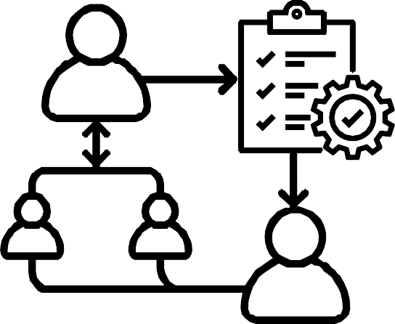

Quality Management
GOALS
-ADA compliant
-Functional equipment
-POS uptime ≥95%
-80% testing before launch
EH&S compliance
70%+ satisfaction
METHODS
Checklists
Trial runs
Monitoring

Slide 15




Change Management
Critical
CCB + Steering
Example: Extend hours
Major
CCB majority
Example: New vendor
Minor
PM approval
Example: Seating change

Slide 16

Quality Plan
Planning Standards:
Functional equipment
Sanitation stations
Vendor compliance
POS testing
ADA & safety checks
Assurance:
Safety inspections
Vendor trial run
POS load testing
Daily monitoring

Slide 17





Quality Control
Food quality checks
Hygiene checks
POS uptime
Wait time monitoring
Surveys

Slide 18


Pilot Evaluation
💳
Transaction data
👨‍🍳
Vendor performance
📝
Student feedback
🛡
Safety audit
📁
Issue logs
Recommendations

Slide 19

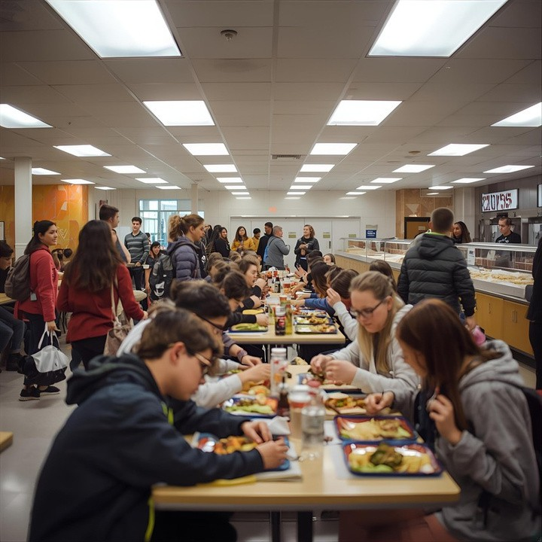
Conclusion
Solves food access gaps
Improves convenience
Supports local vendors
Revenue potential
Scalable model

Slide 20
Questions?

